Slide 1

Web Scraping and Exploratory Data Analysis (EDA) Web Scraping and Exploratory Data Analysis of Plot Sales and Construction Trends in Bangalore

Slide 2
About us
Name:Raghu Nandhaan Meega
Qualification:B-Tech Cse-Ai
I’m passionate about exploring data to build intelligent systems using machine learning and deep learning. Data science allows me to blend research, innovation, and real-world impact—and that’s exactly where I see my future."
Follow us on
LinkedIn:https://www.linkedin.com/in/meegada-raghu-nandhan
Git-hub:https://github.com/mraghu544

Slide 3
1.Business Problem and Use Case Domain Understanding
The real estate market in Bangalore is rapidly evolving, especially in the domain of plot sales and under-construction properties. Buyers, investors, and developers often face challenges due to fragmented information and lack of transparent pricing data. This project addresses the need to aggregate and analyze plot listings and construction trends to provide actionable insights on pricing, availability, and locality-based demand. The analysis aids stakeholders in making informed decisions, identifying growth hotspots, and understanding market dynamics.

Slide 4
2. Objective of the Project
To scrape detailed real estate listings covering multiple property types in Bangalore.
To clean and structure the dataset, capturing features like property type, seller, status, price, area, location, BHK, and RERA registration.
To perform exploratory data analysis (EDA) to identify trends in pricing (rate per sqft and total price), property types, and project status.
To provide visual and statistical insights into Bangalore’s real estate market for plots and constructions.
To assist stakeholders with actionable intelligence on property investments.

Slide 5
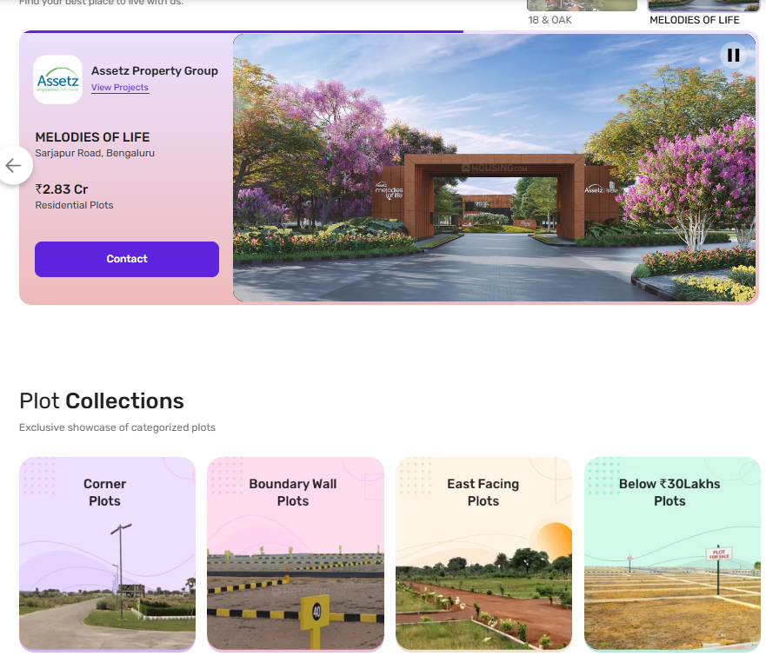
3. Web Scraping – Details
Data Scraped: Property type, seller type, property status (ready/under construction), rate per sqft, area (sqft), location, RERA registration, BHK count, project name, and price (in lakhs).
Methodology:
Utilized Python’s requests library to fetch HTML content.
Parsed the content using BeautifulSoup for targeted data extraction.
Processed pagination to gather approximately 980 listings.
Cleaned and converted textual price and area information into numerical formats for analysis.
Compiled data into a Pandas DataFrame for further processing.

Slide 6
4. Summary of the Data
Total Records: 980 property listings
Columns & Data Types:
property_type (object): Type of property (e.g., plot, apartment, villa)
seller (object): Seller category (individual, agent, builder)
status (object): Construction status (ready, under construction)
rate per sqft (float64): Price per square foot in INR
area (int64): Size of property in square feet
location (object): Locality/neighborhood in Bangalore
RERA (object): Regulatory registration status
BHK (int32): Number of bedrooms, halls, kitchens
projectname (object): Name of the project or development
price(in_lakhs) (float64): Total price in lakhs INR
Data Quality: Complete data with no null values, ready for in-depth EDA and visualization.
Key Focus: Price trends by property type and location, correlation between area, BHK, and price, status-wise comparisons.

Slide 7
1.Data Cleaning Steps
Convert Price and Rate per Sqft to Numeric:
Remove characters like commas, "L", "Cr", and "/ sq ft" from the price and rate per sqft columns.
Convert price strings (e.g., "73.38 L" or "1.11 Cr") to numerical values in INR by multiplying appropriately (1 Lakh = 100,000; 1 Crore = 10,000,000).
Convert rate per sqft strings (e.g., "5,353 / sq ft") into float values.
Convert BHK to Integer: Clean and convert BHK from object to int.
Remove Unnecessary Columns: Drop columns like Unnamed: 0 if it’s just an index.
Standardize Categorical Values:
Clean text data for location, seller, status, and RERA to ensure consistency (remove leading/trailing spaces, fix typos).
Convert these columns to categorical types.
Check for and Handle Duplicates: Remove duplicate listings if any.
Handle Missing Data: Although none found, validate for any null values.

Slide 8
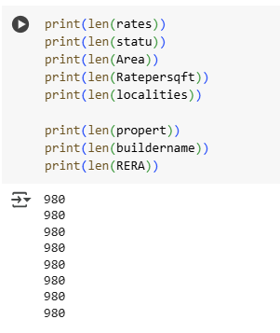
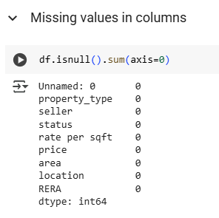
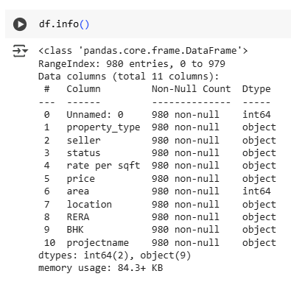
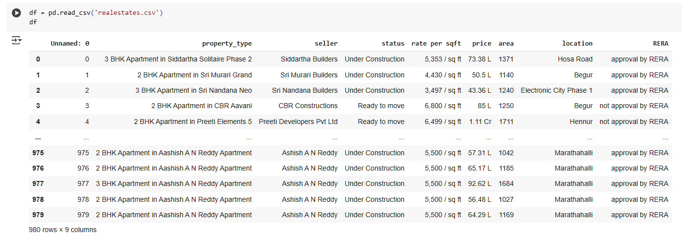

Slide 9
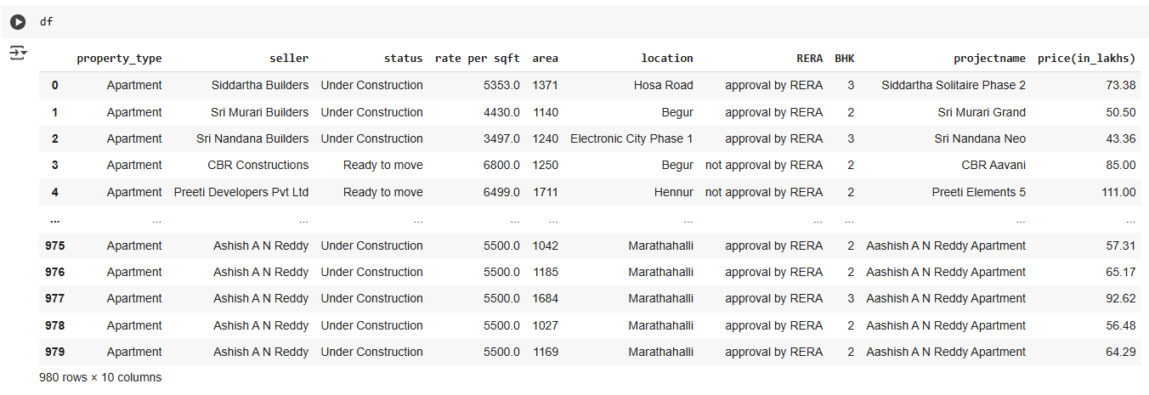
Converted dtypes After Cleaning Data

Slide 10
2. Data Manipulation Steps
Feature Engineering:
Create new columns like price_in_inr (full numeric price), rate_per_sqft_num (numeric rate), and BHK_int (integer BHK).
Calculate derived features such as price_per_sqft = price_in_inr / area for validation.
Group Categories:
Group lesser-known locations into an “Other” category to simplify analysis.
Filtering:
Filter data for plots and constructions separately if analysis focuses on specific property types.
Encoding:
Prepare categorical variables for machine learning or plotting by encoding them if needed (label encoding or one-hot encoding).

Slide 11
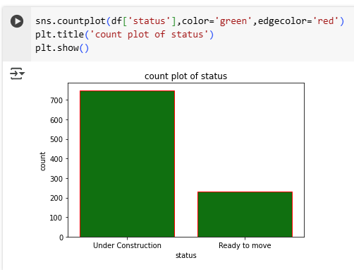
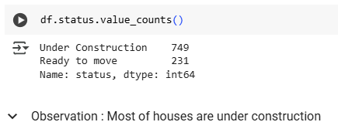
Univariate Analysis:Count plot of Status
Observation & Analysis on Status

Slide 12
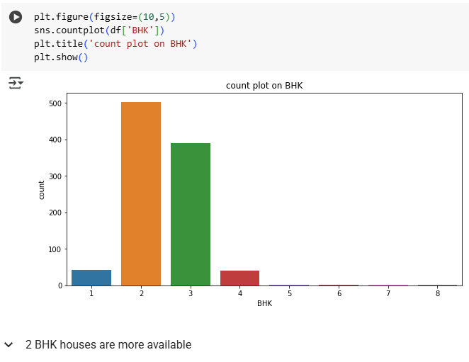
Count plot on BHK

Slide 13
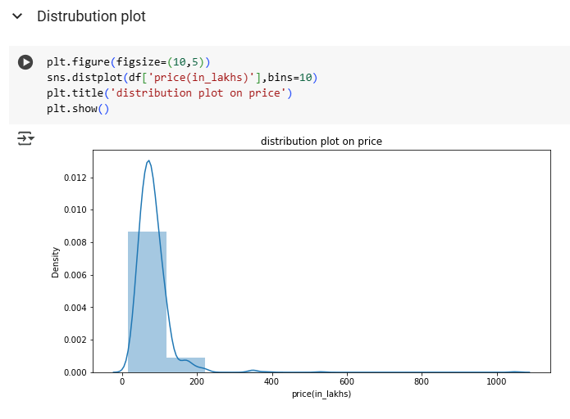
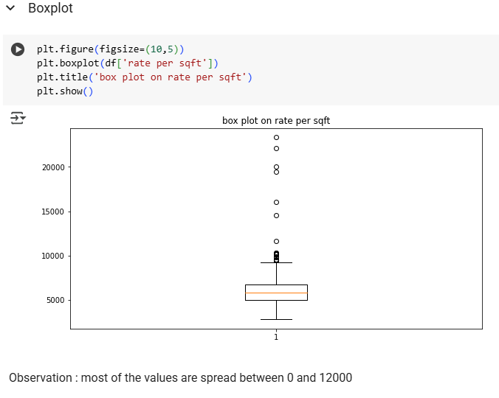
Distribution plot on price & Box plot on rate per sqft

Slide 14
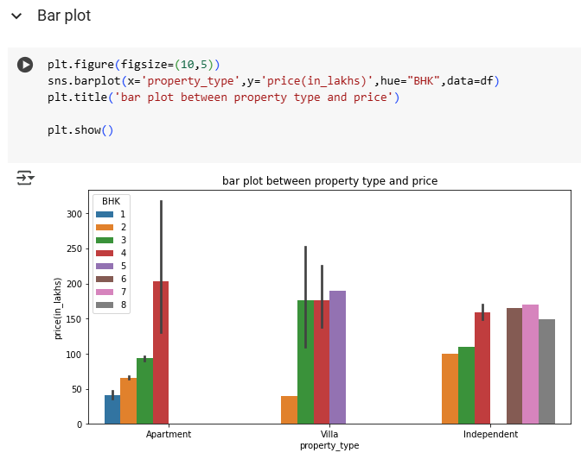
Bar plot Showing the Property Type & Price

Slide 15
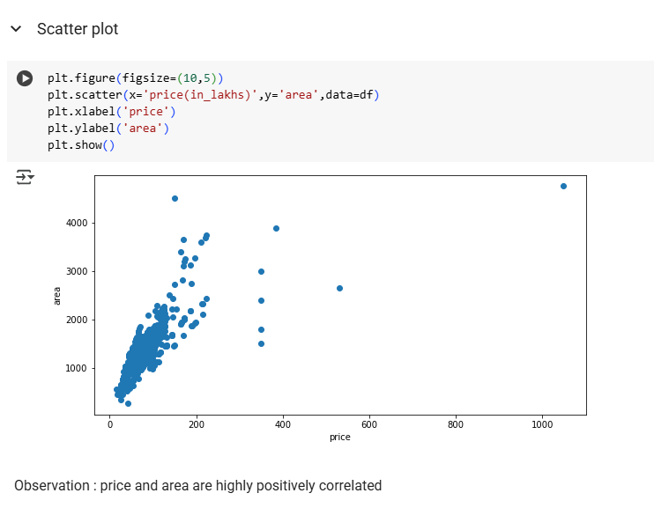
Correlated Scatter plot

Slide 16
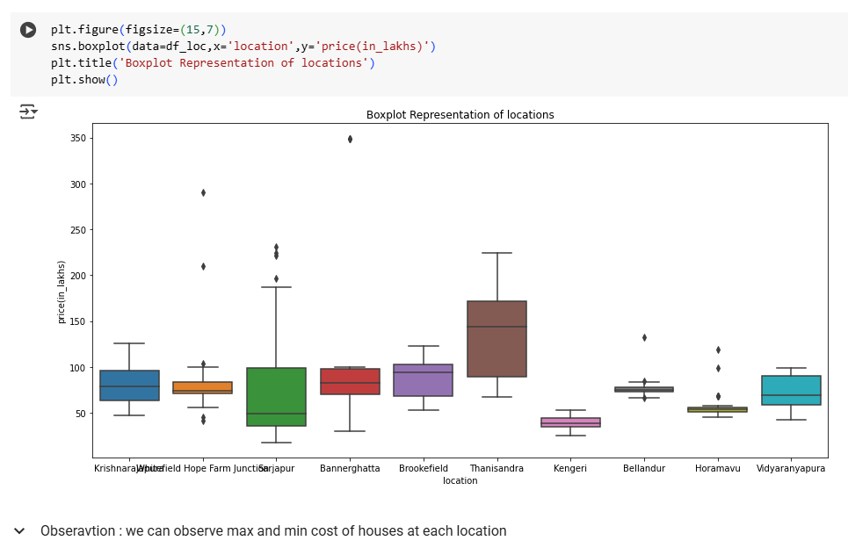
Box plot depicting price in different locations

Slide 17
Conclusion:
Location & Price: Areas like Whitefield, HSR Layout, and Marathahalli show higher prices/sqft.
Builder Impact: Well-known builders consistently charge premium rates.
BHK Impact: 2BHKs are most common and price-efficient; 3BHKs have higher area-to-price value in some locations.
RERA Compliance: Majority of under-construction projects have RERA approval, indicating safer investments.

Slide 18
Q&A Slide – Potential Audience Questions:
Q: Which area is most affordable? A: Electronic City and Begur show lower rates per sqft for 2/3BHKs.
Q: Is RERA approval influencing prices? A: Yes, RERA-approved properties show ~8–10% higher average rates.
Q: Are ready-to-move projects cheaper? A: Not always—under-construction projects in top locations are often more affordable.

Slide 19
Your Experience / Challenges:
Web Scraping: Scraping multiple pages, handling dynamic content and inconsistent data formats was challenging. Used BeautifulSoup and regex for cleanup.
Data Cleaning: Price & rate columns had mixed units (L, Cr, commas), requiring careful parsing and conversion.
Analysis: Handling high-cardinality location data and outliers made visual interpretation harder.
Learning: Gained strong practical skills in data preprocessing, EDA, and real estate trend analysis.

Slide 20

THANK YOU

